Slide 1
ACUTE LYMPHOBLASTIC LEUKEMIA DIAGNOSIS IN BLOOD MICROSCOPIC IMAGES USING LOCAL BINARY PATTERN AND SUPERVISED CLASSIFIER
Manimozhi R(211414205047)
Nandhini R(211414205057)
Priyanka G(211414205081)
Project Guide name
Preethi R

Slide 2
Introduction
Acute lymphoblastic leukemia (ALL) is a subtype of acute leukemia, which is prevalent among children and adults above 60 years. The average age of a person with ALL is 65 years.
The need for automation of leukemia detection arises since current methods involve manual examination of the blood smear as the first step toward diagnosis.
ALL is characterized by the proliferation of blast cells in the bone marrow and subsequent spreading of blast cells into the blood stream.

Slide 3
Abstract
The project presents the classifications and detection of acute lymphoblastic leukemia in blood microscopic images using supervised classifiers.
Input blood microscopic image is converted into gray scale for better features extraction. Then the segmentation process is done by k-means clustering method
The system will be used to classify the queried images automatically to decide the abnormality.
The performance of the system is evaluated through sensitivity, specificity and accuracy
The process of ALL detection is done by fuzzy C-means segmentation, feature extraction and neural network classifier.

Slide 4
Literature survey
TITLE | AUTHOR | YEAR | OBSERVATION | DISADVANTAGE
A survey of mobile cloudcomputing applications: perspectives and challenges. WirelessPersoal Communicatios, | Wang, Y., R. Chen, and D.-C. Wang | 2015 | In this paper we survey existing mobile cloud computing applications, | LOSE OF TEXTER DATA
Computer Aided System for Leukocytes Classification and Segmentation in Blood Smear Images, in Frontiers of Information Technology | Muhammad Sajjad, S.K., Muhammad Shoaib, Hazrat Ali, Zahoor Jan, | 2016 | Detection and counting of white blood cells (WBC) in blood samples provides valuable information to medical specialists | MORE NOISE

Slide 5
TITLE | AUTHOR | YEAR | OBSERVATION | DISADVANTAGE
Nuclei segmentation of leukocytes in blood smear digital images | Abbas, N | 2015 | The Leukocytes are differentiated from each other on the basis of their nuclei, | IRREGULAR SHAPE PATTREN
Automatic recognition of five types of whiteInternational Conference Image Analysis and Recognition. | Rezatofighi, S.H., K. Khaksari, and H. Soltanian-Zadeh | 2010. | proposesimage processing algorithms to recognize five types of white blood cells in peripheral blood automatically. | HARD TO DIFFERNTIATE CORPUSCLES AND TISSUE FLUID

Slide 6
Existing methods
Otsu threshold
Principal Component Analysis
GLCM features
KNN and FNN classifier

Slide 7
Drawbacks
Thresholding approach doesn’t provide optimal results
PCA has low discriminatory power
FNN is slow training for large feature set.

Slide 8
Proposed system
ALL detection from blood microscopic images
using,
Clustering.
Hybrid (color, texture and shape) features.
supervised Classifier.
Advantages:
Lloyd’s has high robustness and low complexity.
DRLBP has better discriminatory power
SVM is fast and better compatible in classification.
Notes:
PNN is a feedforward neural network, which is widely used in classification and pattern recognition problems.
DRLBP discriminative robust local binary patterns

Slide 9
Software requirements
MATLAB 7.10 or above versions.

Slide 10
Block diagram
Test images
Pre-
processing
Fuzzy C Means Clustering
Local Binary pattern(LBP)
Hybrid Feature Extraction
Training samples
Pre-Processing
Reference Feature
SVM Classification
Decision
(ALL/non ALL

Slide 11
Methodologies
Lab color space conversion
Fuzzy Clustering
DRLBP (Discriminative Robust Local binary Pattern)
Color and Shape features
SVM classifier

Slide 12
Novelty
This project is used to detect the blood cells cancer accurately. Since the blood samples are matched with several training set blood samples, the accuracy is high.
In existing system, blood samples are detected using threshold values so accuracy is low.
Fuzzy clustering will help to focus the blood cells from different positions such as primary, secondary, foreground and background whereas in existing system only foreground image is considered.
LBP method is used to find the affected blood cells effectively.

Slide 13
Modules split up
Pre processing
Fuzzy c-means clustering
Local binary pattern
Feature extraction
SVM classification

Slide 14
preprocessing
The pre processing includes the image resizing, Gray color space conversion and de-noising.
Before the segmentation process, we are going to resize the input image into fixed Row and Column size [256 256] using imresize command.
Then the input image is converted into gray scale conversion for accurate segmentation.
The conversion is done by RGB2GRAY Matlab commands
To reduce the effect of noise we apply the median filter for de-noising.

Slide 15
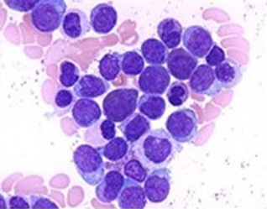
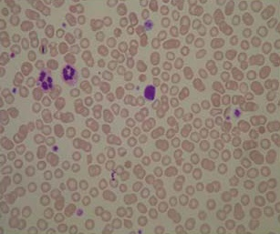
Sample Images
Leukemia
Non-Leukemia

Slide 16
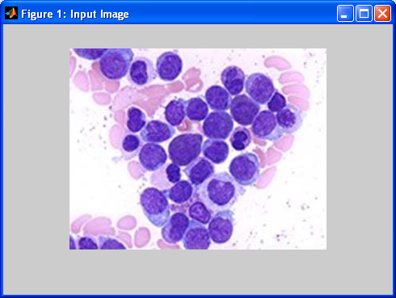
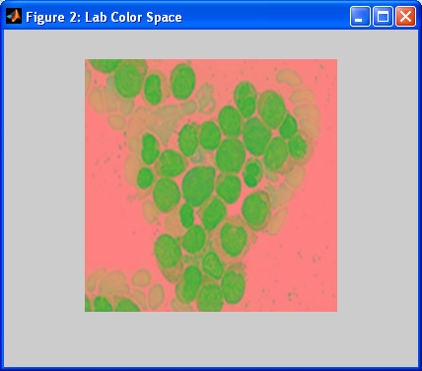
Input’s RGB and Lab Color Space

Slide 17
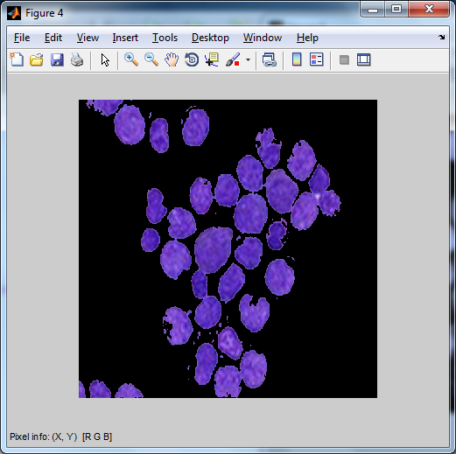
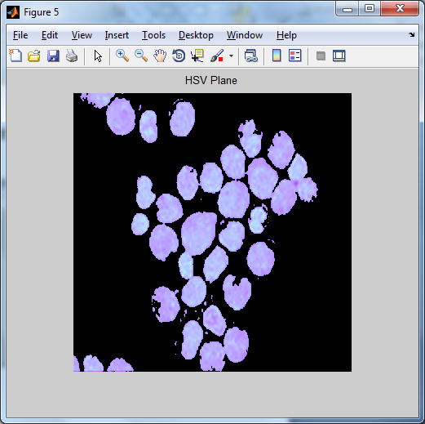
Color space conversion
RGB Color Model
HSV Color Model

Slide 18
Fuzzy C-Means Clustering
Clustering of numerical data forms the basis of many classification and system modeling algorithms. The purpose of clustering is to identify natural groupings of data from a large data set to produce a concise representation of a system's behavior.
Fuzzy C-means clustering is a data clustering technique in which a dataset is grouped into n clusters with every datapoint in the dataset belonging to every cluster to a certain degree. It is rather easy to implement and apply even on large data sets, particularly when using heuristics such as Lloyd’s algorithm.

Slide 19
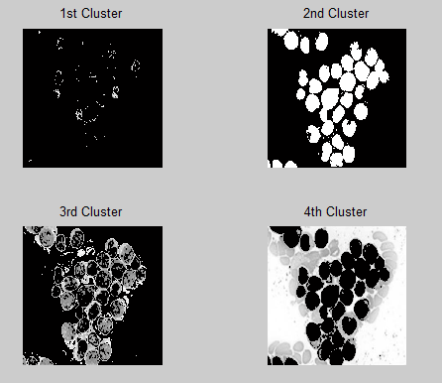
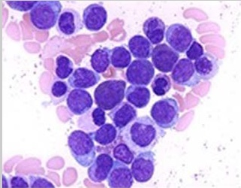
Segmented Results
Input image
Segmented Cluster

Slide 20
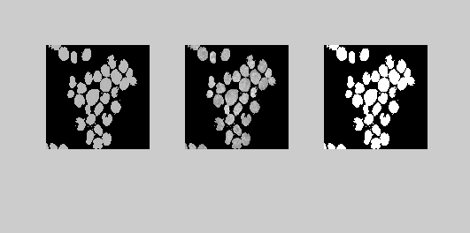
HSV Plane Separation

Slide 21
Local binary pattern
The descriptor local binary pattern is used to compare all the pixels including the center pixel with the neighboring pixels in the kernel to improve the robustness against the illumination variation.
An LBP code for a neighborhood was produced by multiplying the threshold values with weights given to the corresponding pixels, and summing up the result.
LBP codes are weighed using gradient vector to generate the histogram of robust LBP and discriminative features are determined from the robust local binary pattern codes.
DRLBP is represented interms of set of normalized histogram bins as local texture features.

Slide 22
Continues..
It is used to discriminate the local edge texture of fingerprint invariant to changes of contrast and shape.
DRLDP is a gray-scale texture pattern which characterizes the spatial structure of a local image texture.
A DRLDP operator computes the edge response values in all eight directions at each pixel position and generates a code from the relative strength magnitude.
DRLDP feature describes the local primitives including different types of curves, corners, and junctions, more stably and retains more information.

Slide 23
Feature Extraction
Energy
Entropy
Contrast
Correlation
Homogeneity

Slide 24


Continues…
Energy : It is a measure the homogeneousness of the image and can be calculated from the normalized COM. It is a suitable measure for detection of disorder in texture image.
Entropy : Entropy gives a measure of complexity of the image. Complex textures tend to have higher entropy
Where,
p(i , j) is the co occurrence matrix

Slide 25
Continues…
Contrast : Measures the local variations and texture of shadow depth in the gray level co-occurrence matrix.
Correlation Coefficient : Measures the joint probability occurrence of the specified pixel pairs.
sum(sum((x- μx)(y-μy)p(x , y)/σ_{x}σ_{y}))
Homogeneity : Measures the closeness of the distribution of elements in the GLCM to the GLCM diagonal.
sum(sum(p(x , y)/(1 + [x-y])))

Slide 26
SVM Classification
Support vector machine(SVM) classification is used for constructing a selection surface in the function space that bisects the 2 classes, i.e., cancerous and noncancerous, and maximizes the margin of separation among training of factors.
SVMs is a promising nonlinear nonparametric classification approach, which already confirmed properly outcomes within the scientific diagnostics
An SVM is mostly a two-magnificence classifier. it may be both linear or nonlinear.we select a linear SVM two-magnificence classifier
as it is not computationally pricey, it does not appoint the kernel trick explicitly, and it achieves, in widespread, a very good performance.

Slide 27
Continues…
Two especially critical issues are: 1) the determination of the most appropriate feature subspace where to carry out the classification task and 2) model selection.
In this paper, these two issues are addressed through a classification system that optimizes the SVM classifier accuracy for this kind of imagery.
This system is based on a genetic optimization framework formulated in such a way as to detect the best discriminative features without requiring the a priori setting of their number by the user and to estimate the best SVM parameters (i.e., regularization and kernel parameters) in a completely automatic way.
For these purposes, it exploits fitness criteria intrinsically related to the generalization capabilities of SVM classifiers.

Slide 28
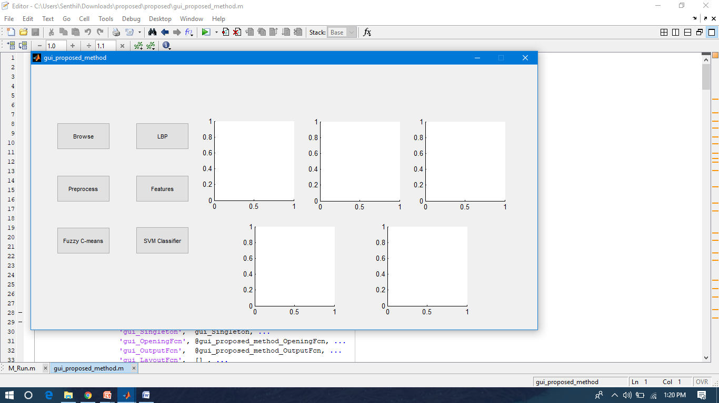
Snapshots of output

Slide 29
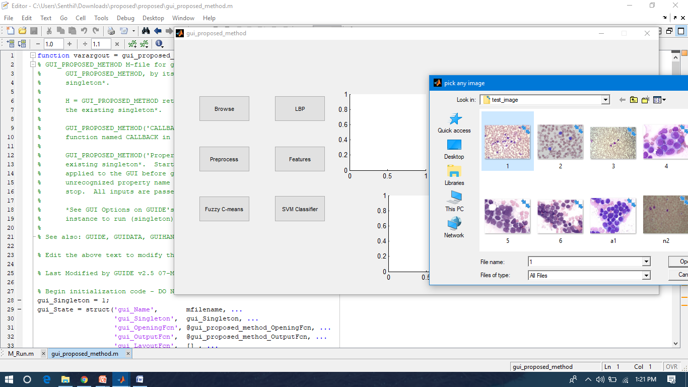
Input image selection

Slide 30
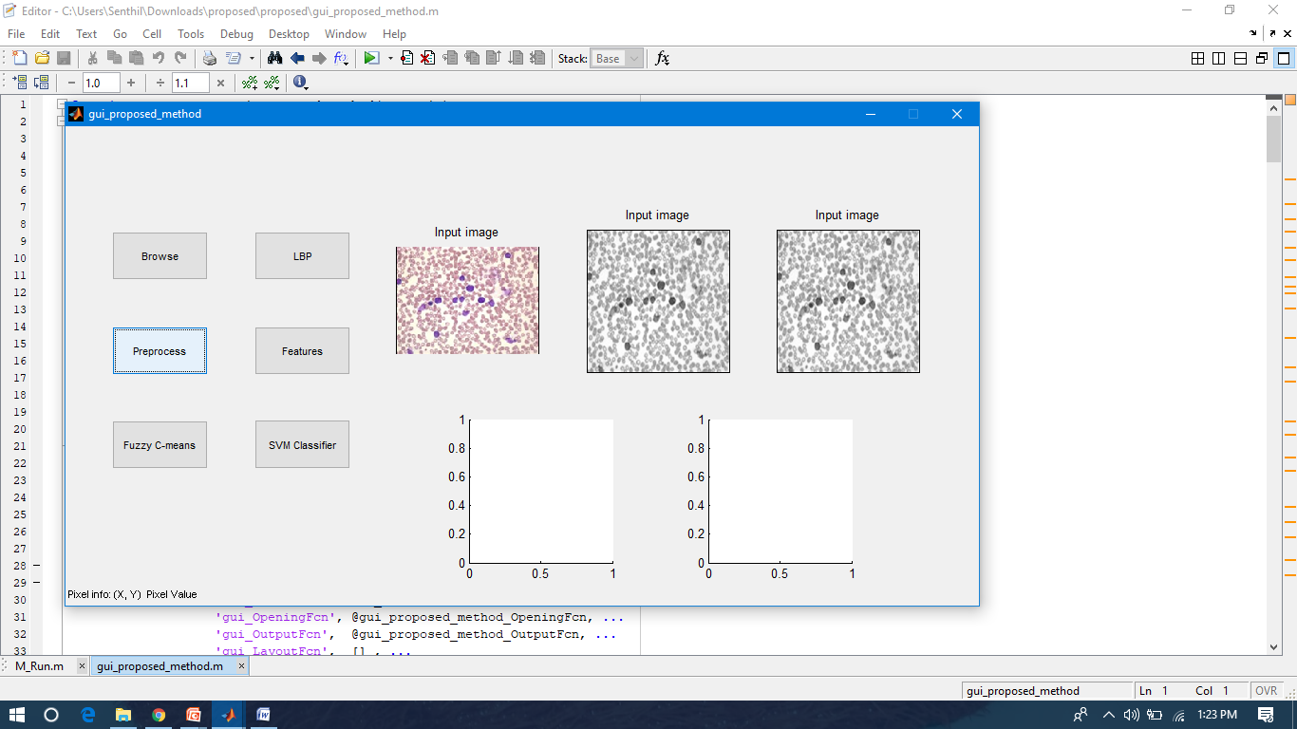
preprocessing

Slide 31
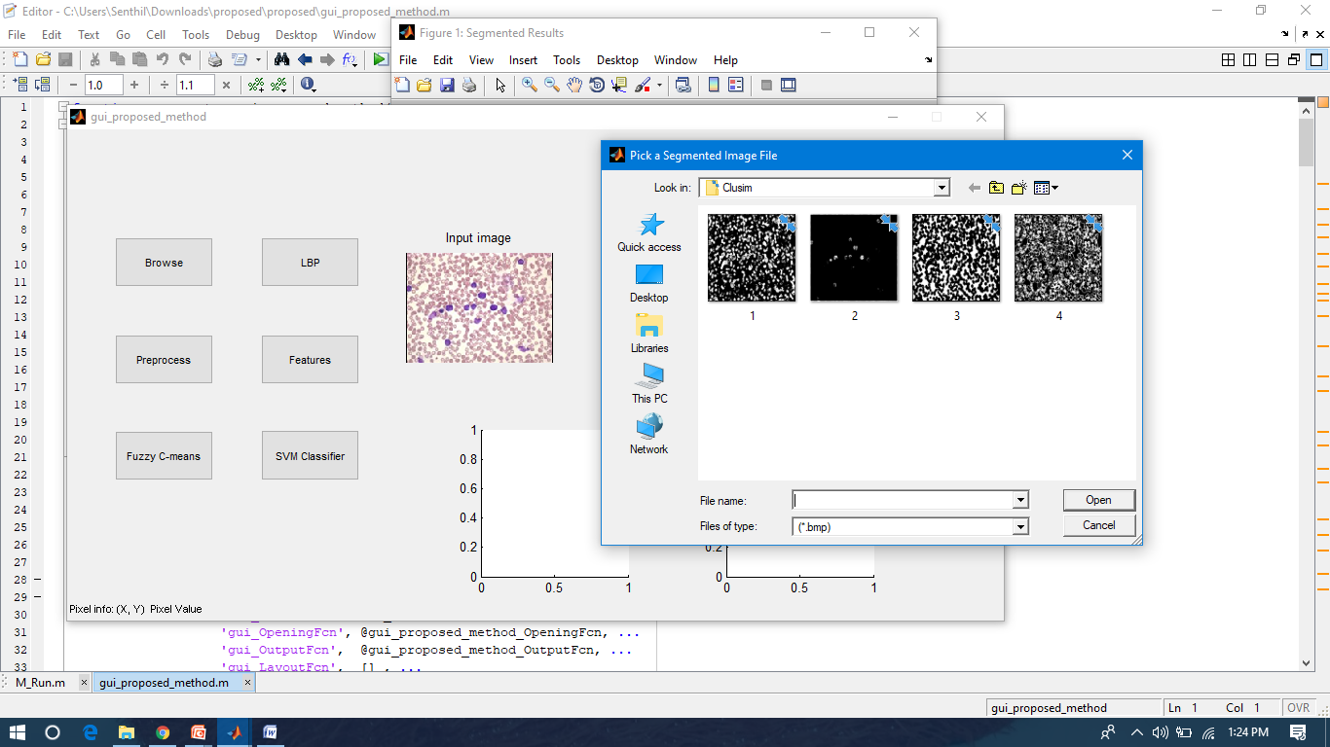
Selection of segmented image

Slide 32
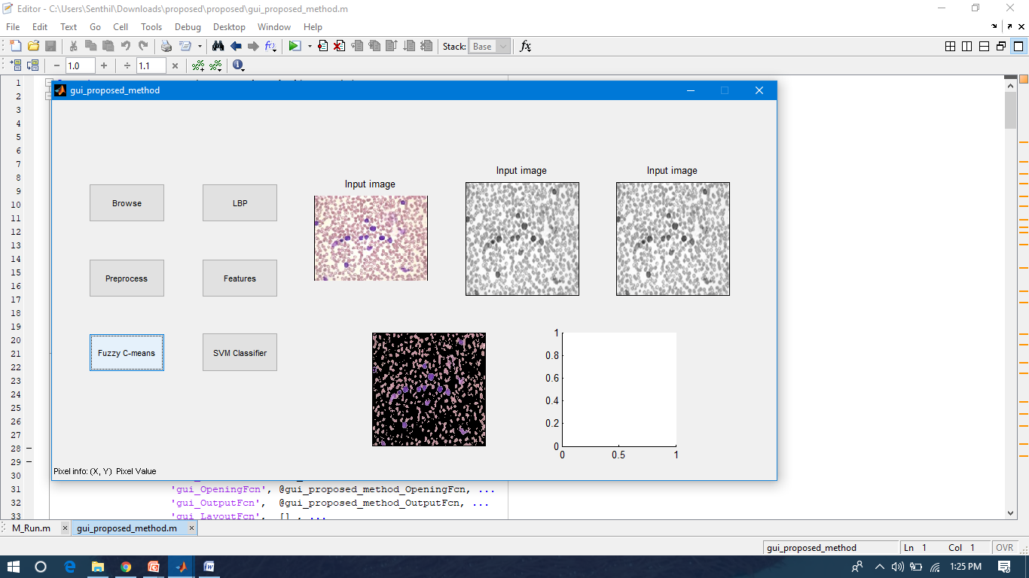
Fuzzy c means clustering

Slide 33
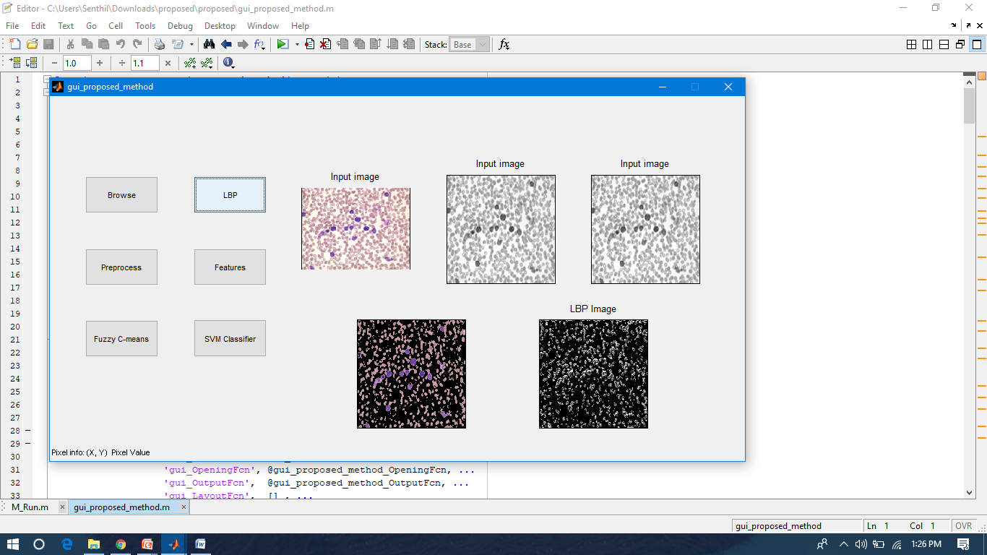
LBP image

Slide 34
Application
Automated decision support system for biomedical.
Accurate result generation for cancer detection.

Slide 35
References
[1] F. Scotti, “Automatic morphological analysis for acute leukemia identification in peripheral blood microscope images,” in Proc. CIMSA, 2005, pp. 96–101.
[2] V. Piuri and F. Scotti, “Morphological classification of blood leucocytes by microscope images,” in Proc. CIMSA, 2004, pp. 103–108
[3] M. Subrajeet, D. Patra, and S. Satpathy, “Automated leukemia detection in blood microscopic images using statistical texture analysis,” in Proc. Int. Conf. Commun. Comput. Security, 2011, pp. 184–187.
[4] H. Ramoser, V. Laurain, H. Bischof, and R. Ecker, “Leukocyte segmentation and classification in blood-smear images,” in Proc. IEEE EMBS, 2006, pp. 3371–3374
[5] C. Reta, L. Altamirano, J. A. Gonzalez, R. Diaz, and J. S. Guichard, “Segmentation of bone marrow cell images for morphological classification of acute leukemia,” in Proc. 23rd FLAIRS, 2010, pp. 86–91.

Slide 36
References
[6] Prinyakupt, J. and C. Pluempitiwiriyawej, Segmentation of white blood cells and comparison of cell morphology by linear and naïve Bayes classifiers. Biomedical engineering online, 2015. 14(1): p. 1.
[7] Nazlibilek, S., et al., Automatic segmentation, counting, size determination and classification of white blood cells. Measurement, 2014. 55: p. 58- 65.
[8] Marzuki, N.I.C., N.H. Mahmood, and M.A.A. Razak, Segmentation of White Blood Cell Nucleus Using Active Contour. Jurnal Teknologi, 2015. 74(6).
[9] Mahmood, N.H., et al., Blood cells extraction using color based segmentation technique. International journal of life sciences biotechnology and pharma research, 2013. 2(2): p. 233-240
[10] Duan, J. and L. Yu. A WBC segmentation methord based on HSI color space. in Broadband Network and Multimedia Technology (IC-BNMT), 2011 4th IEEE International Conference on. 2011. IEEE.

Slide 37
References
[11] Ko, B.C., J.-W. Gim, and J.-Y. Nam, Automatic white blood cell segmentation using stepwise merging rules and gradient vector flow snake. Micron, 2011. 42(7): p. 695-705.
[12] Ravikumar, S., Image segmentation and classification of white blood cells with the extreme learning machine and the fast relevance vector machine. Artificial cells, nanomedicine, and biotechnology, 2016. 44(3): p. 985-989.
[13] Muhammad Sajjad, S.K., Muhammad Shoaib, Hazrat Ali Computer Aided System for Leukocytes Classification and Segmentation in Blood Smear Images, in Frontiers of Information Technology2016.: Islamabad27
[14] Sholeh, F.I. White blood cell segmentation for fresh blood smear images. in Advanced Computer Science and Information Systems (ICACSIS), 2013 International Conference on. 2013. IEEE.
[15] Abbas, N., et al., Nuclei segmentation of leukocytes in blood smear digital images. Pak. J. Pharm. Sci, 2015. 28(5): p. 1801-1806.

